Slide 1
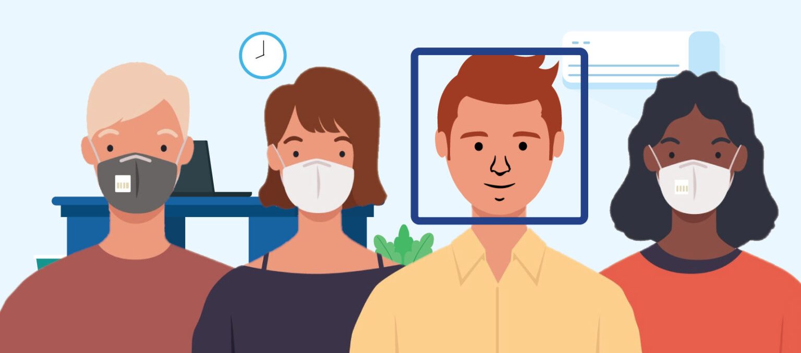
Face Mask Detection System Using Deep Learning and Computer Vision
Group Members,
Onkar A. Deshpande.
Aniket A. Omanna.
Dinesh B. Patil.

Slide 2
INDEX
Covid-19
Introduction
Hardware requirements
How It Works
Machine Learning
Deep Learning
Dataset
Frameworks
Applications

Slide 3
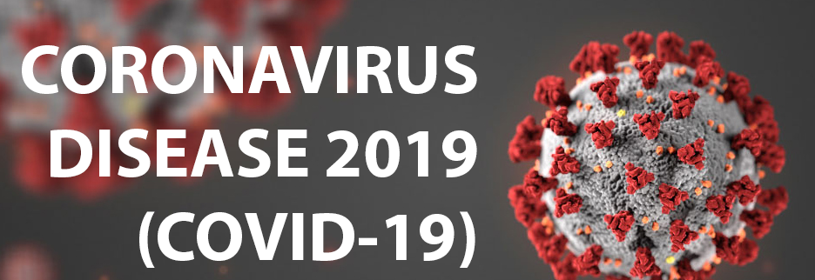
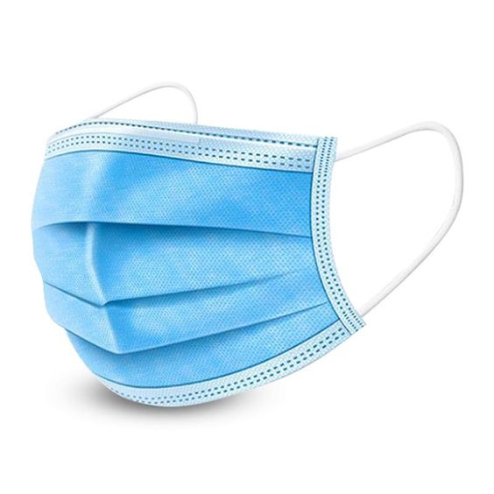
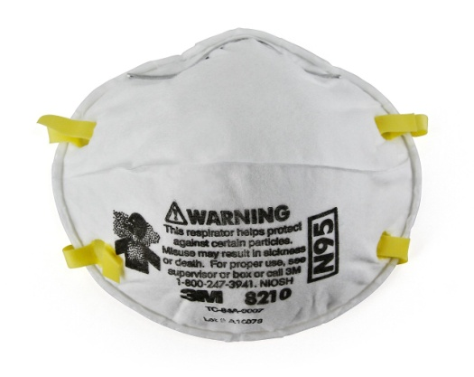
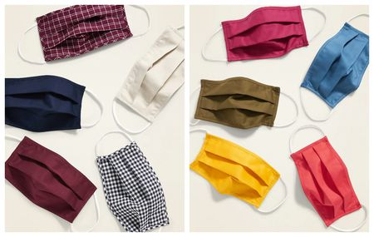
Covid-19
Types of Masks
Surgical Masks
N95 Masks
Cloth Masks

Slide 4
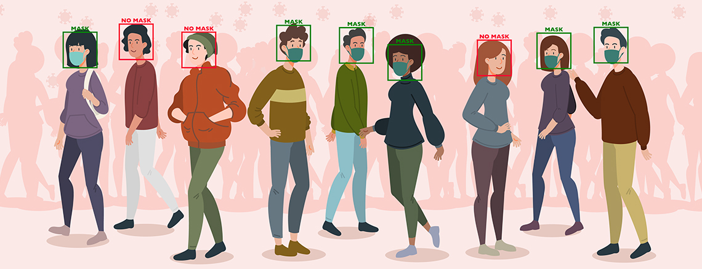
Introduction
Our Face Mask Detection system built with OpenCV, Keras/TensorFlow using Deep Learning and Computer Vision.

Slide 5
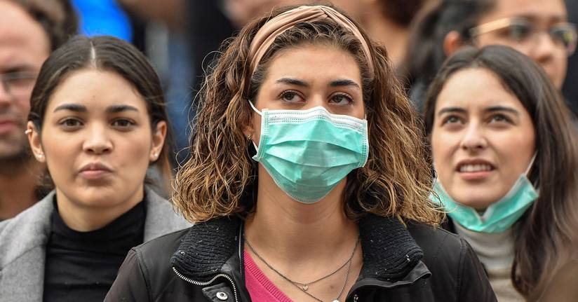
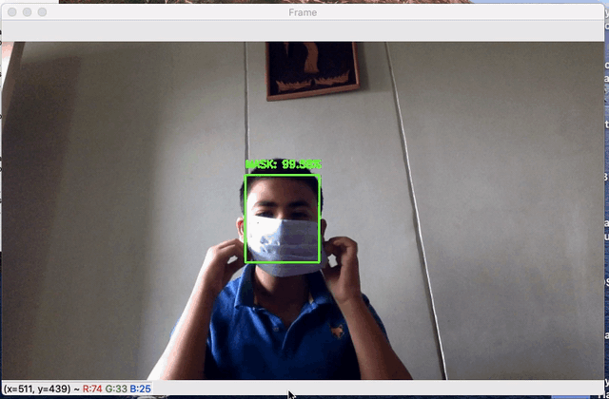
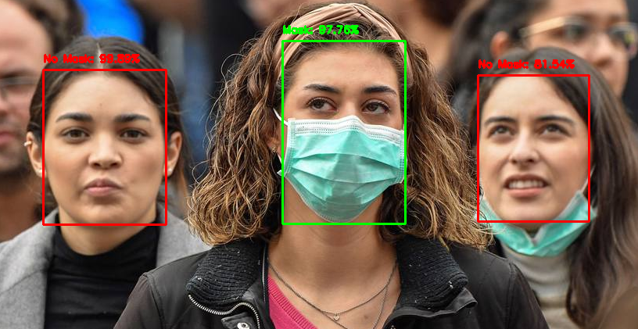
Introduction
We can detect face masks in Static Images as well as in Real-time Video streams.
Static Images
Real-time Video stream

Slide 6
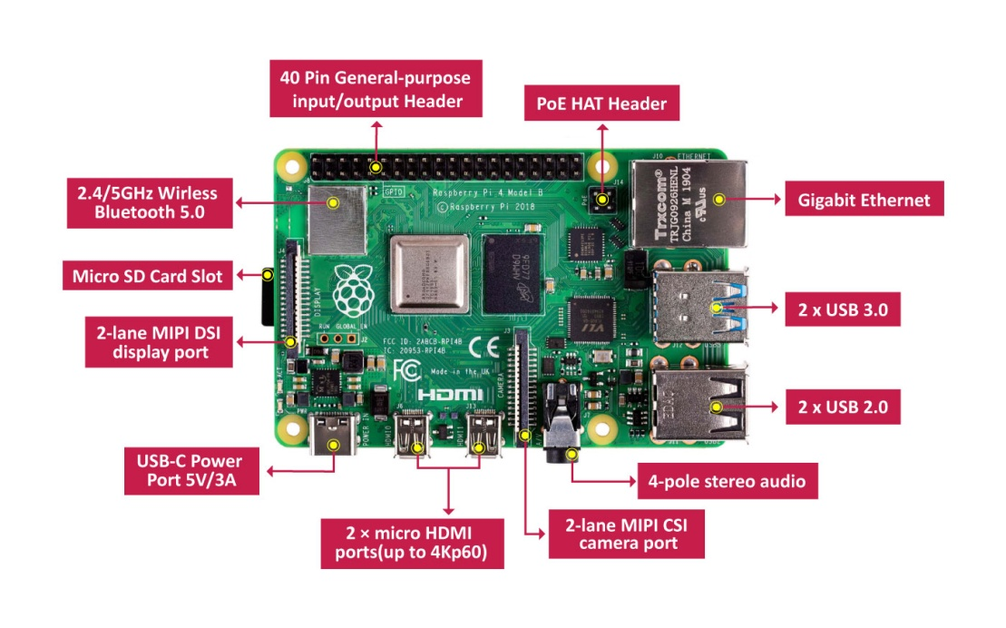
Hardware Requirements
Raspberry pi 4

Slide 7
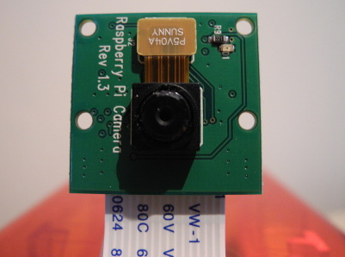

Hardware Requirements
Pi Camera
Speaker

Slide 8
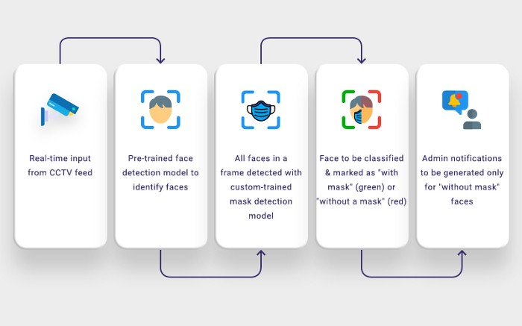

How It Works
Real-time input
Form CCTV feed
Pre-trained face
Detection model to
Identify faces
All faces in a
Frame detected
with
Custom-trained
Mask detection
model
Face be classified
& marked as
“with mask”
Or
“without mask”
Audio output
generated only
when
“without mask”
Face is detected
D

Slide 9
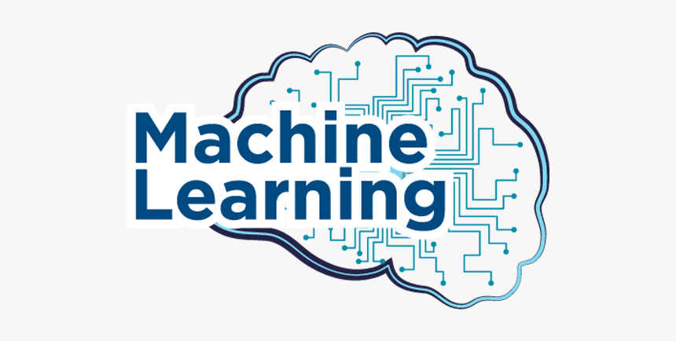
Machine Learning
Machine learning is an application of artificial intelligence (AI) that provides systems the ability to automatically learn and improve from experience without being explicitly programmed.

Slide 10
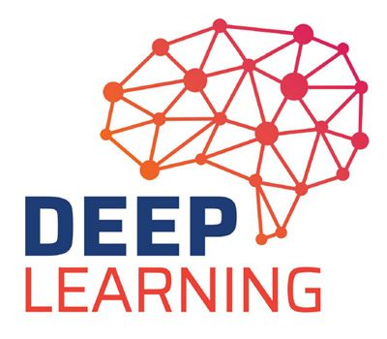
Deep Learning
Deep learning is a subset of machine learning in artificial intelligence (AI) that has networks capable of learning unsupervised from data that is unstructured or unlabeled. Also known as deep neural learning or deep neural network.

Slide 11
Dataset
A data set is a collection of data. A collection of instances is a dataset and when working with Deep learning methods we typically need a two datasets for different purposes.
Training Dataset: A dataset that we feed into our Deep learning algorithm to train our model.
Testing Dataset: A dataset that we use to validate the accuracy of our model but is not used to train the model. It may be called the validation dataset.

Slide 12
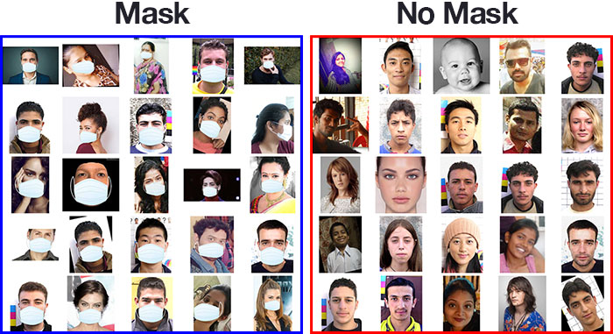
Dataset
Our dataset consists of 3835 images belonging to two classes:
With Mask: 1916 images
Without Mask: 1919 images

Slide 13

Dataset
To create this dataset, We follow these two steps:
Taking normal images of faces
Then creating a custom computer vision Python script to add face masks to them, thereby creating an artificial (but still real-world applicable) dataset.
We need to first start with an image of a person not wearing a face mask:

Slide 14
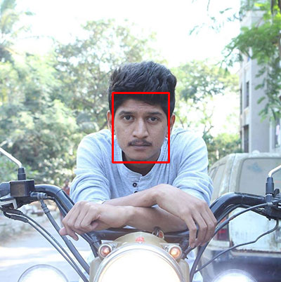

Dataset
2. We apply face detection to compute the bounding box location of the face in the image:
3. Once we know where in the image the face is, we can extract the face Region of Interest (ROI):

Slide 15
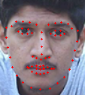
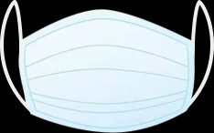
Dataset
4. We apply facial landmarks, allowing us to localize the eyes, nose, mouth, etc.:
5. Next, we need an image of a mask (with a transparent background) such as the one below:

Slide 16
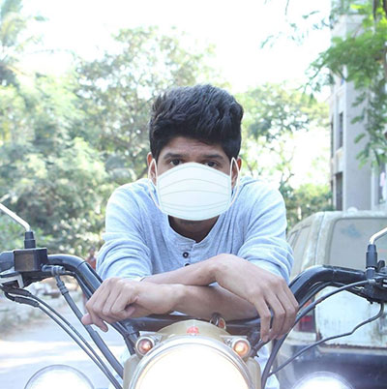
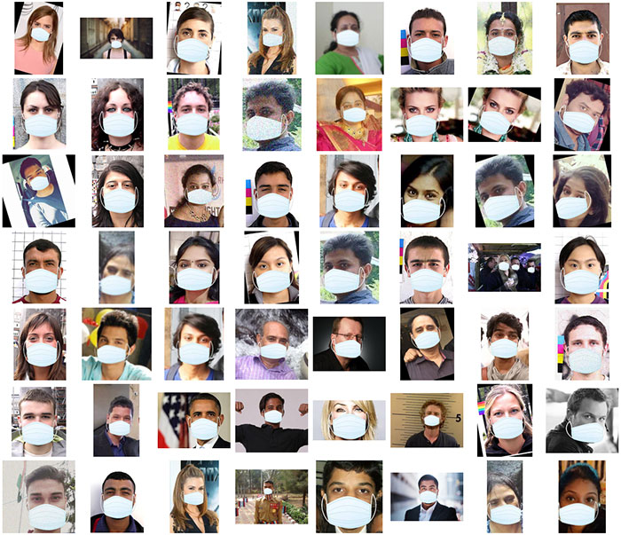
Dataset
This mask will be automatically applied to the face by using
the facial landmarks to compute where the mask will be placed.
7. We can then repeat this process for all of our input images, thereby creating our artificial face mask dataset:

Slide 17

Frameworks
OpenCV means Open Source Computer Vision Library.
It is a library of programming functions mainly aimed at real time computer vision.
This library originally developed by Intel.

Slide 18

Frameworks
Caffe is a deep learning framework made with expression, speed, and modularity in mind.
It is developed by Berkeley AI Research (BAIR) and by community contributors.
We use caffe deep learning framework for face detection.

Slide 19

Frameworks
TensorFlow is an end-to-end open source platform for machine learning.
Easy model building
Powerful experimentation for research

Slide 20

Frameworks
Keras is the most used deep learning framework. Because Keras makes it easier to run new experiments.
Take advantage of the full deployment capabilities of the TensorFlow platform.
Keras is used by CERN, NASA, NIH, and many more scientific organizations around the world.

Slide 21
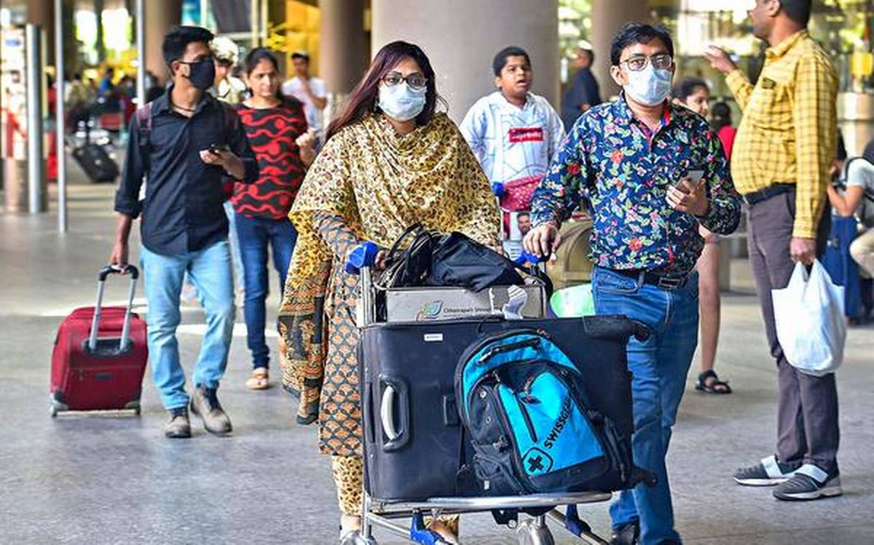
Applications
Airports
The Face Mask Detection System can be used at airports to detect travelers without masks. Face data of travelers can be captured in the system at the entrance. If a traveler is found to be without a face mask, their picture is sent to the airport authorities so that they could take quick action.

Slide 22
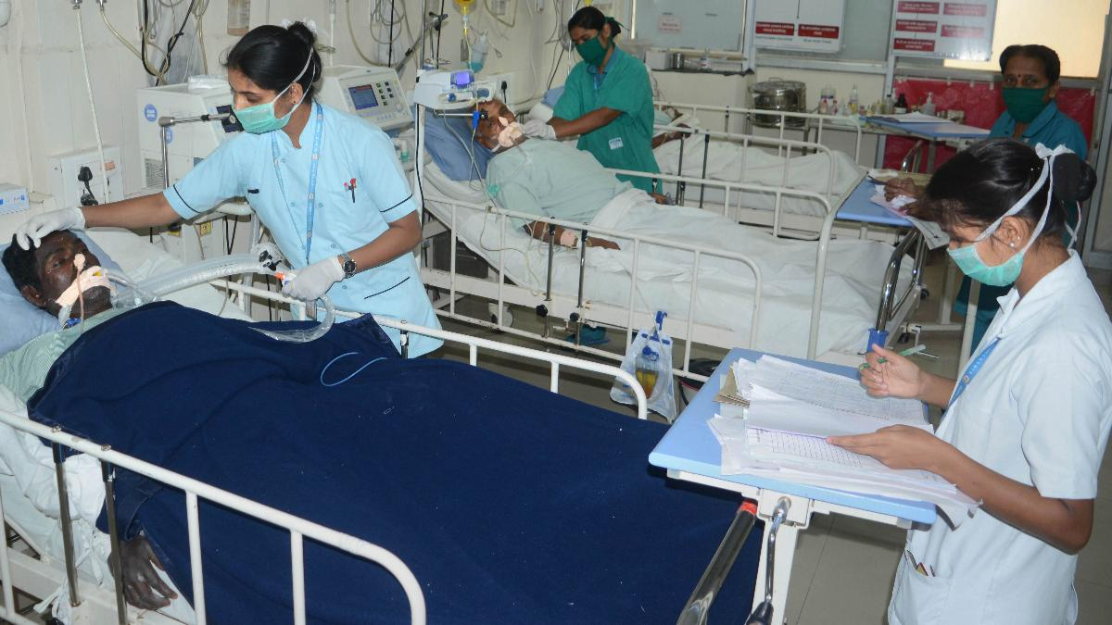
Applications
Hospitals
Using Face Mask Detection System, Hospitals can monitor if their staff is wearing masks during their shift or not. If any health worker is found without a mask, they will receive a notification with a reminder to wear a mask.

Slide 23
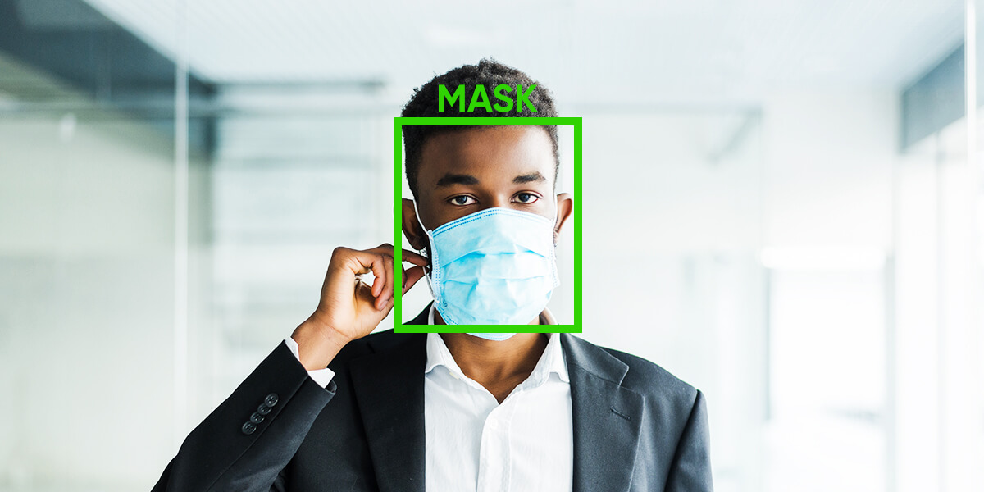
Applications
Offices
The Face Mask Detection System can be used at office premises to detect if employees are maintaining safety standards at work. It monitors employees without masks and sends them a reminder to wear a mask.

Slide 24
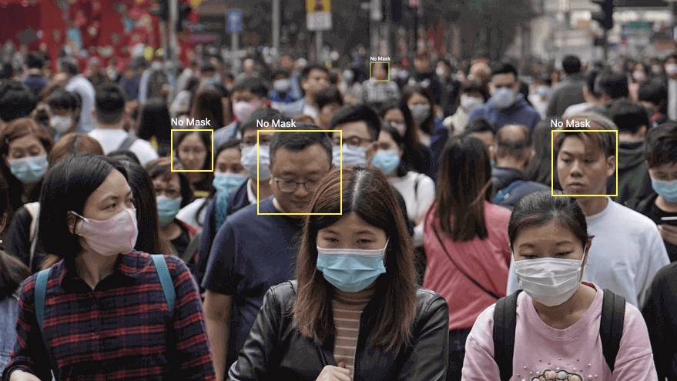
Applications
Government
To limit the spread of coronavirus, the police could deploy the face mask detector on its fleet of surveillance cameras to enforce the compulsory wearing of face masks in public places.

Slide 25
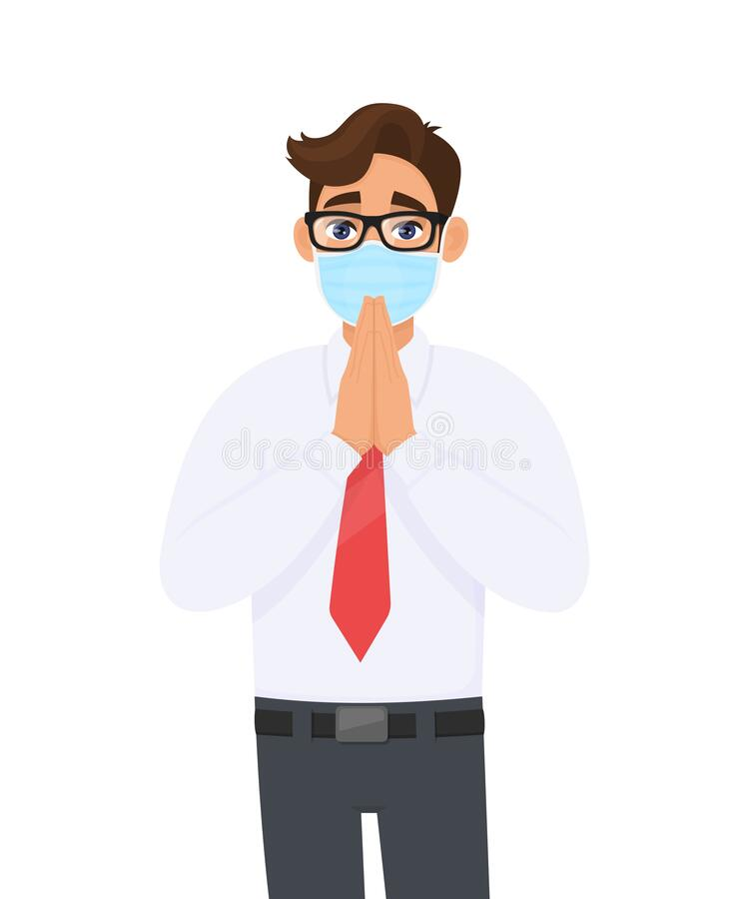
Thank You

